Slide 1
Creating a Marketing-Effective
Storefront

Slide 2
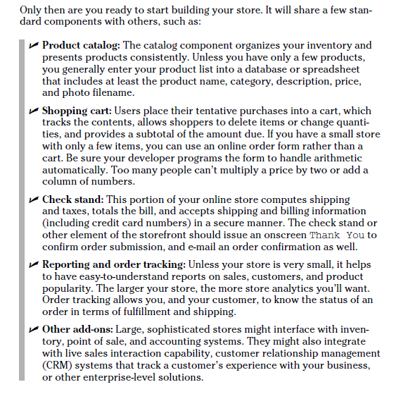
Examining the Key Components of an Online Store

Slide 3
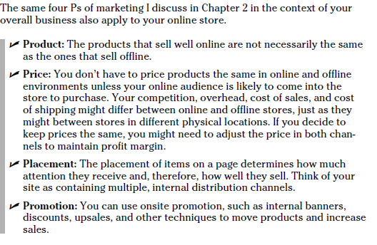

Slide 4
Selling B2B (Business to Business) with an Online Store
If you’re a wholesaler or manufacturer, consider implementing a password login so only approved dealers can view your wholesale prices and place orders.
Link customers to your dealers’ Web sites to buy, and have dealers link back to your site for product details or tech support.

Slide 5
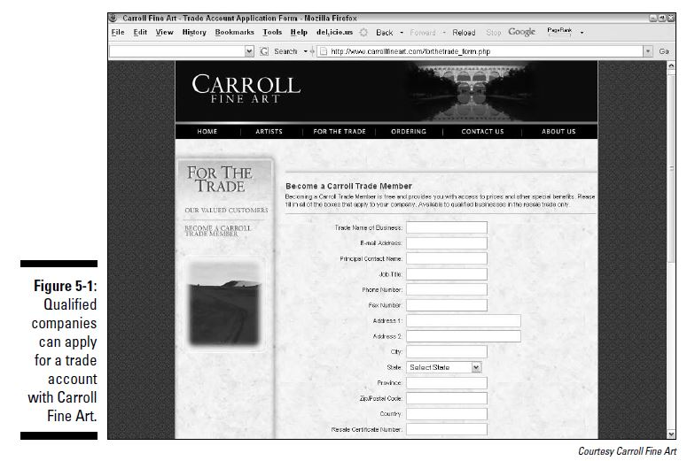

Slide 6
Merchandizing
Merchandising refers to the selection and display of products in your store. If you have a bricks-and-clicks operation, you’re under no compulsion to sell any of the same products both online and offline, let alone all of them. For example, Jelly Belly discovered that the 1-pound packages of jellybeans so popular in their stores were a dud online, but high-margin, accessorized gift packages performed better on the site. While customers can still buy jellybeans online, JellyBelly.com is merchandised quite differently from Jelly Belly shops in malls.

Slide 7
Merchandising Your Online Store
(Stocking the online store)
Deciding what types of products to sell First,
- decide what you’ll sell, whether a subset of your inventory or all of it.
- check out the criteria for picking products suitable for online sales at http://tihomir.org/the-most-profitableproducts-to-sell-online
Choosing specific items to include in your catalog
- Your second decision is how many items will be in your catalog to start with and eventually. Catalog size is one of the main factors to consider when selecting a storefront solution. Given intense competition online and shoppers’ desires for good selections, you need a critical mass of products and choices — unless you have a very narrow niche with high demand.
Pricing your products finally, decide on pricing.
- Check competitors’ prices - one of the many comparison sites like PriceGrabber.com, Shopzilla. com, MySimon.com, or BizRate.com.

Slide 8
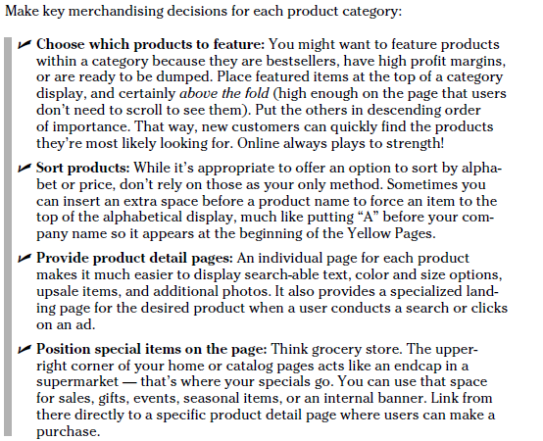
Displaying products

Slide 9
Informing users of product options
Product detail pages should offer shoppers choices of color, size, or other attributes.

Slide 10
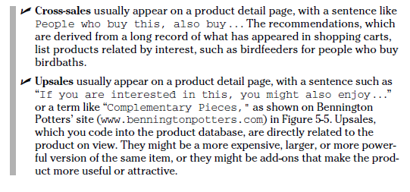
Enhancing revenue

Slide 11
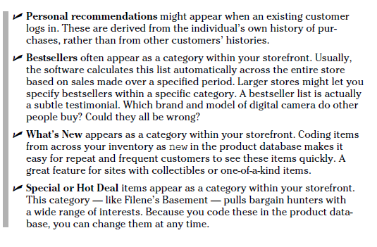

Slide 12
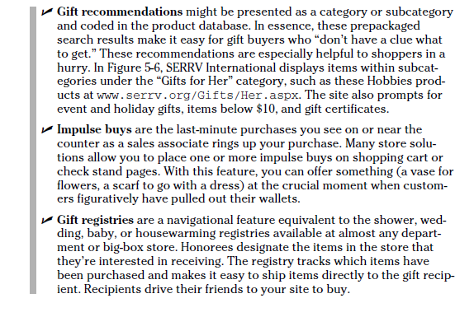

Slide 13
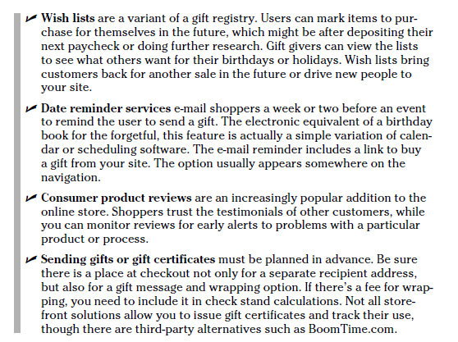
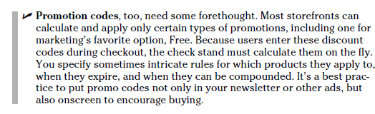

Slide 14
Including product detail
If you’re selling gift items, display how the wrapped package will look when received. Photograph packaged sets of goods priced as one basket or kit. When possible, picture people using or modeling your products.(sales. HatsintheBelfry (www.hatsinthe belfry.com) incorporates people as models on their site)
If your products are available in different colors, display color swatches on the detail page.

Slide 15
Making It Easy for Your Customers to Buy
1)Providing a product search engine(users might want to search by the following criteria, alone or in combination: Product name, Product type, Price,Product attributes, such as size, color, or material,Brand. Highquality search engines can respond by algorithm (rule) to misspellings.
2)Implementing 2 clicks to buy(To move clients toward purchase as quickly as possible,put a Buy Now (good) or Add to Cart).
3)Offering multiple payment options
4)Supporting customers(Enable customers to communicate with a real person,; Spell out warranty, refund, and return policies,;Ensure privacy and security. Reassure your customers that their personal information, including e-mail addresses;
5)Fulfilling orders(Packing slips and shipping labels, Shipping confirmation)

Slide 16
Shipping is a Marketing Issue
Deciding what to charge for shipping(is it free, If you’re new to this business, test your packaging, shipping, and carrier selection,especially for fragile or perishable goods. Simply ship samples to yourself or friends.
Communicating your shipping policies
(ex The Postal Service delivers on Saturday with no additional charge;FedEx charges extra)

Slide 17
Specifying Storefront Requirements
No-storefront selling solutions -- the least-expensive way to start selling online is to use the no-storefront selling solution. In other words, forego all the hassle of a Web site and storefront. Simply sell your products directly through Amazon Marketplace,eBay
One-stop storebuilders As the e-commerce variant of the template sites one-stop storebuilders are generic, somewhat inflexible solutions, but they quickly solve most of your problems. True, one-stop storebuilders help you buy a domain name, build template-based Web pages, stock a product catalog, supply the shopping cart and check stand components, provide a payment system through PayPal or a merchant gateway, and host your site. Very inexpensive and relatively easy to use, the entry-level versions work best for small stores.(eBay Stores, Yahoo! Stores)
Specialty storebuilders Sometimes called malls, specialty storebuilders have a mission. Usually, a hosting company decides to focus on a particular industry or geographical area and markets e-commerce templates specifically tailored to the needs of that audience. The host then creates a directory of all the shops as a virtual mall and promotes the mall as an online destination. Some high-end malls,like Shop.com, allow buyers to use a universal shopping cart across all theirstores, saving the user time and making purchasing easier.

Slide 18
Assembly storefronts Many companies host a storefront solution on their third-party server that you link to from your site, wherever it might be hosted. These assembly storefronts have all the essential components for e-commerce, but you might need technical assistance to make the link interface smooth. In essence, you create and support two sites that share a similar look and feel.
Integrated storefronts Developers integrate commercial, off-the-shelf, or open-source e-commerce components (drupal,opencart)with your existing site to create a seamless online store solution. Depending on its size and other factors, your storefront might be hosted on a dedicated server, on your shared server, or on the developer’s server.
This approach is more complex, but also more customizable and flexible than others. Translation: It costs more money. Some developers license and resell the same storefront solution to all their e-commerce customers. This is fine, as long as the store does what you need.

Slide 19
Custom e-commerce solutions For maximum flexibility and control, some developers prefer to write their own e-commerce packages. The upside: A custom shopping site that’s industry-tailored might be very cost-effective for your particular business.
Enterprise e-commerce solutions Usually expensive, integrated solutions for large, high-end stores interface with retail, point of sales (POS) systems, bookkeeping, inventory, manufacturing, customer relationship management (CRM), enterprise resource planning (ERP), and other systems.
(example www.godaddy.com/ gdshop/ecommerce/cart.asp)

